Slide 1
CAPSTONE PROJECT
GROUP NAME – NIBBLE NINJAS
MEMBERS :
ABHISHEK GUNA – 202301148
MANTHAN JETHVA – 202301175
MEET DOBARIYA – 202301115
SHUBHAM KANKOTIA – 202301155
GITHUB REPOSATORY LINK -
GitHub - HINOKAM-ii/capstone project

Slide 2
PROBLEM STATEMENT
Spell Checker :
Develop a spell checker application that checks the spelling of words in a given text document, utilizing data structures like hash tables or trie for efficient dictionary storage and lookup. After highlighting the misspelled words, with the user’s approval, replace them with the correct spellings.

Slide 3
DATA STRUCTURE USED - HASH MAP
BENEFITS OF HASH MAP :
Efficiency :
HASH TABLE CONSTANT TIME COMPLEXITY FOR MOST BASIC OPERATIONS LIKE INSERTION , DELETION AND SEARCH ON AVERAGE CASES .
Search Speed:
WHILE TRIES OFFER EFFICIENT PREFIX-BASED SEARCHES , HASH TABLES CAN BE EQUALLY EFFICIENT FOR EXACT MATCHING SEARCHES, WHICH IS OFTEN THE PRIMARY REQUIREMENT FOR SPELL CHECKERS.
Ease of Implementation :
HASH TABLES ARE GENERALLY SIMPLER TO IMPLEMENT AND UNDERSTAND COMPARED TO TRIES, WHICH REQUIRE A MORE COMPLEX STRUCTURE INVOLVING MULTIPLE NODES ANDPOINTERS.
Flexibility :
HASH TABLES CAN BE EASILY ADAPTED TO HANDLE VARIOUSTYPES OF KEYS, NOT JUST STRINGS. THIS MAKES THEMSUITABLE FOR SPELL CHECKERS THAT MAY NEED TO HANDLEDIFFERENT TYPES OF DATA BEYOND JUST WORDS

Slide 4
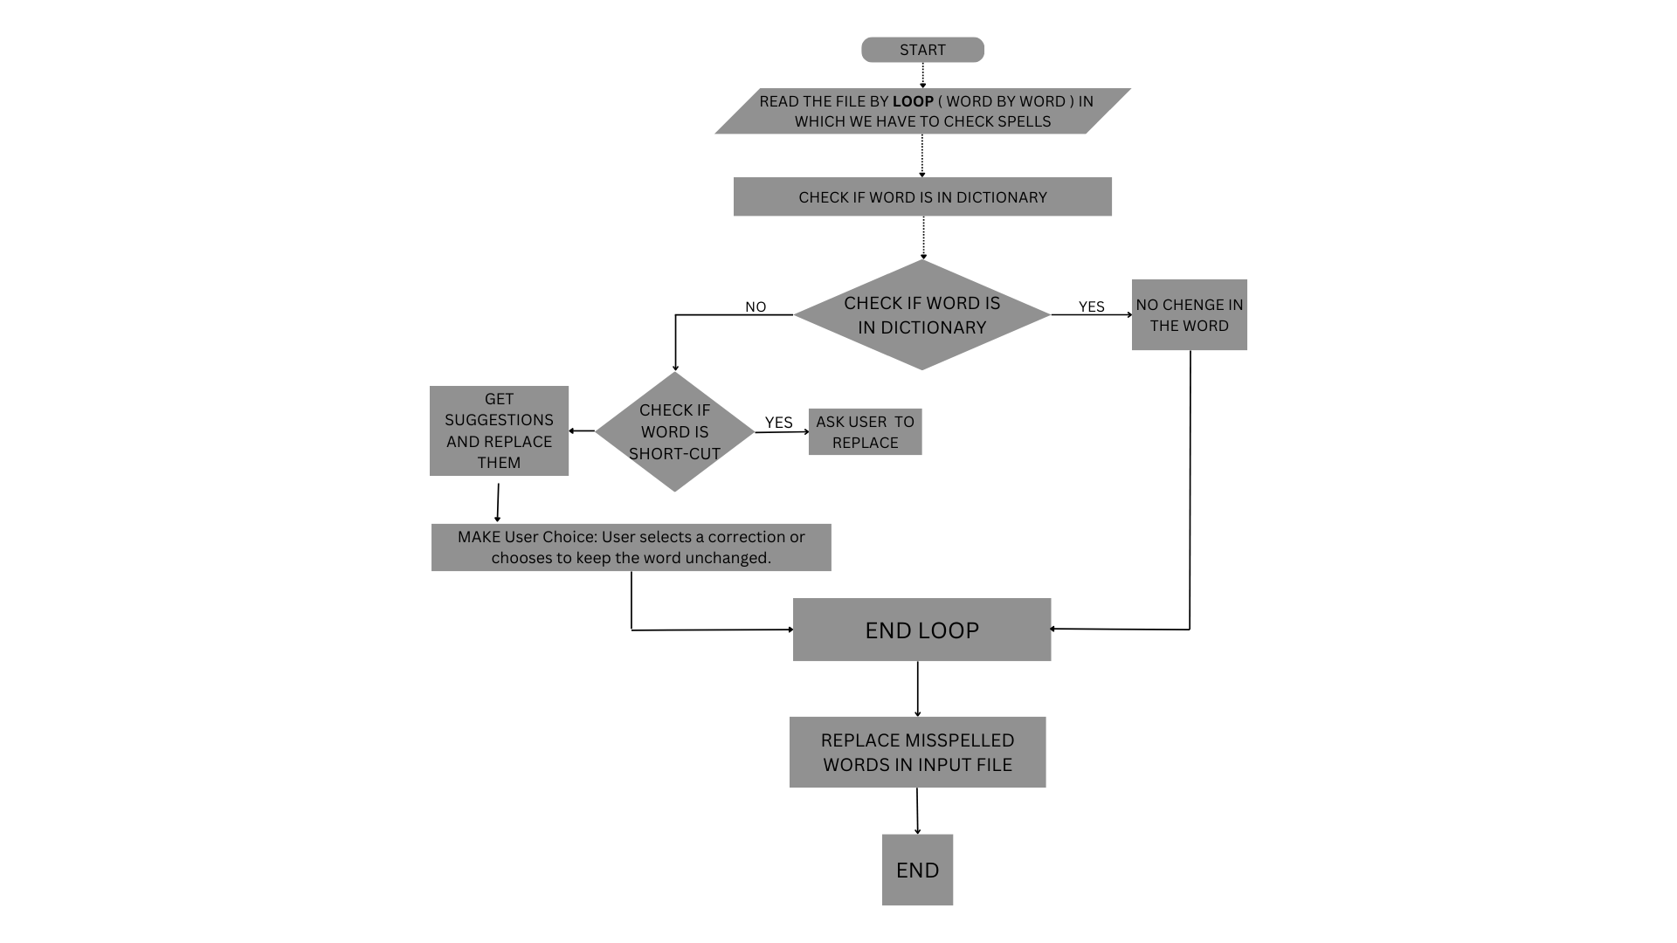

Slide 5
1 . Implementation of dictionary :
creation of data structure to store dictionaries (all corrected words) . We could use data structures like hash tables, trie .
2 . Spell Checking Algorithm :
Developing an algorithm to compare words from the input text with those in the dictionary to identify misspelled words . This algorithm may include techniques such as Levenshtein distance, which measures the similarity between two words by calculating the minimum number of operations.
3 . Suggestions Generation:
Implementing a mechanism to generate suggestions for correcting misspelled words based on their similarity to correctly spelled words in the dictionary. This could involve techniques like generating all possible variations of a word .
4 . Creating console based User Interface .

Slide 6
Needed function in class of data structure :
1 . Two functions to insert words into the dictionary.
2 . Function to check if a word is in the dictionary.
3 . Function to implement Levenshtein distance.
4 . Function to generate suggestions for misspelled words
(which is using another function Levenshtein distance).
5 . Function to check and showing spelling errors in a input file and suggest corrections.
6 . Function to replace misspelled words.
Some function for additional features (BONUS) :
⇾ Functions to add shortcuts to words and replace it in the input file .
⇾ Function to add any particular new word to dictionary based on user
experience .

Slide 7
Pseudocode of our code –
// Define a class for spell checker
Class spellchecker:
Define an unordered_map dictionary to store correct words
Define an unordered_map short_cut to store shortcuts
Define main_dictionary and shortcut_location strings
// Constructor
Function spellchecker():
Call insert_dictionary(main_dictionary)
Call insert_shortcut_file(shortcut_location)
// (1.1) . Function to insert a word into the dictionary
Function insert_spell(word):
dictionary[word] = true
// (1.2) . Function to insert words from a dictionary file
Function insert_dictionary(dictionary_name):
Open the dictionary file
If the file is open:
Read each word from the file and insert it into the
dictionary
Close the file
Else:
Print an error message

Slide 8
// 2 . Function to check if a word is in the dictionary
Function is_in_dictionary(word):
Return true if word is in dictionary, else false
// 3 . function to calculate Levenshtein distance between two strings
Function Distance(str1, str2):
n = length of str1
m = length of str2
Create a 2D array dis[n+1][m+1]
// Initialize the first row and column
For i from 0 to n:
dis[i][0] = i
For j from 0 to m:
dis[0][j] = j
// Calculate distances using dynamic programming
For i from 1 to n:
For j from 1 to m:
If str1[i-1] equals str2[j-1]:
dis[i][j] = dis[i-1][j-1]
Else:
dis[i][j] = 1 + minimum of {dis[i-1][j], dis[i][j-1],
dis[i-1][j-1]}
Return dis[n][m]

Slide 9
// 4 . Function to generate suggestions for a misspelled word
Function suggestion(MisSpellWord):
Initialize an empty vector final_suggestion
Open the main dictionary file
If the file is open:
Read each word from the file
Calculate Levenshtein distance between each word and
MisSpellWord
Calculate priority based on distance and matching
characters
Store the word and priority in suggestion_word vector
Sort suggestion_word based on priority
Add top 5 suggestions to final_suggestion
If suggestion_word is empty, print "zero suggestion"
Else:
Print an error message
Return final_suggestion

Slide 10
// 5 . Function to check spelling errors in a file and suggest
corrections
Function checking_file(filename):
Open the input file
If the file is open:
Read each character from the file
If the character is a letter, add it to a word
If a word is formed:
If the word is in the dictionary, print it
Else, print the word underlined
Reset the word
Else, print the character
Else:
Print an error message
Return count of misspelled words

Slide 11
// 6 . Function to replace misspelled words in a file
Function replace_spell(file_name):
Open the input file
If the file is open:
Create a temporary file
Read each character from the file
If the character is a letter, add it to a word
If a word is formed:
If the word is a shortcut, ask for replacement
Else if the word is in the dictionary, write it to the
temporary file
Else, suggest corrections and write the chosen word to
the temporary file
Reset the word
Else, write the character to the temporary file
Close both files, remove the original file, and rename the
temporary file

Slide 12
// functions to add shortcuts to words and replace it in the input file
// Function to insert a shortcut word into the shortcuts dictionary
Function insert_shortcut_word(key, ans):
Open the shortcut file
If the file is open:
Write the key and answer to the file
Close the file
Else:
Print an error message
// Function to read shortcut words from a file
Function insert_shortcut_file(shortcut_filename):
Open the shortcut file
If the file is open:
Read each key and answer from the file and store them in
the shortcuts dictionary
Close the file

Slide 13
// function to add any particular new word to dictionary
function insert_spell_to_dictionary(word):
// Open the main_dictionary file in append mode
file = open(main_dictionary, append mode)
// Write the word to the file followed by a newline character
write word to file
// Close the file
close file

Slide 14
Time Complexity of overall project :
The time complexity ranges from O(N) to O(M * N), where N is the number of words in the main dictionary, M is the length of the longest word, and sometimes M represents the number of characters in the input file.
The operations on the main dictionary, such as insertion, lookup, and suggestion generation, are typically linear or quadratic in the size of the dictionary or the length of words.
The time complexity of checking and correcting words in input files also depends on the size of the files and the number of words in the dictionary.
Space Complexity of overall project :
The space complexity is mainly influenced by the size of the dictionary and the number of shortcut mappings.
The primary data structures, such as unordered maps for the main dictionary and shortcuts, consume space proportional to the number of words or mappings.
Other variables and temporary storage used during file processing have constant space requirements.
FOR MORE IDEA VISIOT GITHUB REPOSATORY AND DOCUMENT UPLODED IN IT .

